Slide 1


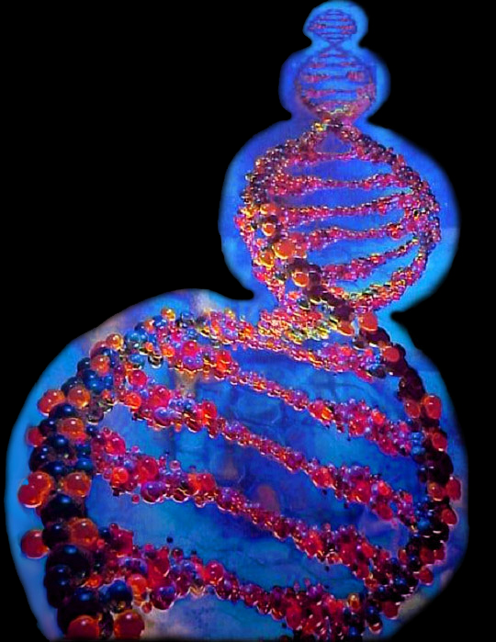





Radioactivity 101
Spontaneous emission of radiation directly from unstable atomic nuclei or as a consequence of a nuclear reaction:
the radiation emitted by radioactive substances – viz.
alpha particles, protons, neutrons, electrons, gamma rays.
www.floydnolenjonesministries.com 2-11-25

Slide 2
Nucleus – the positively charged dense and heavy central part of an atom
All atoms are electrically neutral.
They have the same number of electrons in orbit as they have protons in the nucleus.
Proton – a positive charged particle found
in the nucleus of an atom
Electron – a negative charged particle that orbits the nucleus of an atom: it takes 1837 of them to equal the weight of one proton
Neutron – a neutrally charged particle in an atom’s nucleus: it consists of a proton and an electron (thus weighs the same as a proton)

Slide 3
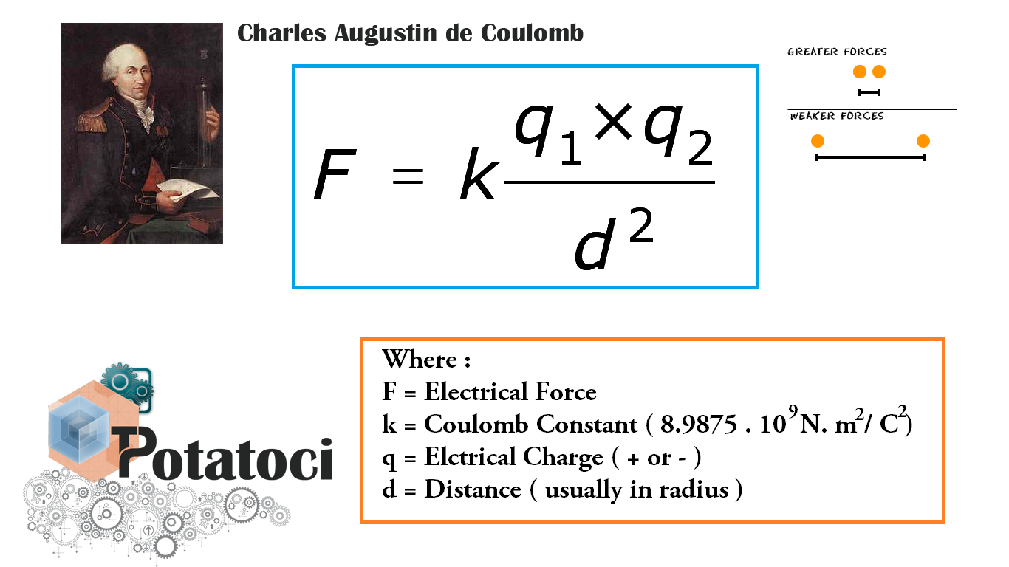
Basic structure of an Atom
Electron circling a nucleus
Protons and Neutrons in the nucleus
Protons all have a positive charge.
Since like charges repel, why doesn’t the atom’s nucleus
fly apart ?
(the “coulomb” force)
For an extremely
small distance the “strong” or binding force acts in the opposite direction
and thereby holds
the nucleus together.
center to center

Slide 4
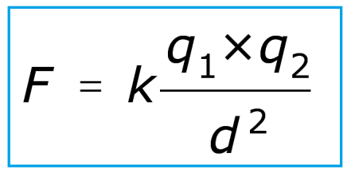
Basic structure of an Atom
Electron circling nucleus
Protons and Neutrons in the nucleus
Electrostatic force F
between q₁ and q₂
is directly proportional to the product of the strength of their charges and inversely proportional to the square
of the distance
between their centers.
The electric force between charged bodies at rest
is called the electrostatic or Coulomb force.
Though known earlier, this inverse-square law was
first published in 1785
by French physicist
Charles-Augustin de Coulomb

Slide 5
₆C¹²
Atomic mass (AMU) = protons + neutrons
₆C¹⁴
Atomic number
= protons
6:8 is not 1:1 – nearly, so weakly radioactive
C¹² = 12 – 6 = 6 neutrons in the nucleus is 1:1
C¹⁴ = 14 – 6 = 8 neutrons in the nucleus is 6:8
Unstable elements “want” a nearer 1 to 1 ratio
of protons to neutrons in the nucleus
of their atoms in order to become stable.
To approach 1:1, elements spontaneously
decay emitting various particles.

Slide 6
Radioactive – Why ?
Atomic mass (AMU) = protons + neutrons
₉₂U²³⁸
Atomic number
= protons
92:146 is
not near 1:1, it is .63:1
238 – 92 = 146 Neutrons in the nucleus
Atoms with too many neutrons in the nucleus are unstable as their nuclei are too large for the nuclear “strong” or binding force (which only acts over a small distance) to overcome the “coulomb” repulsion force
& hold all the subatomic particles together (238 here)
(especially the 92⁺ charged protons that repel each other)
An AMU > 60 is too large for the binding force to hold: particles are ejected from the nucleus to obtain stability.

Slide 7
Beta Particle Decay
Neutrons in heavy elements (= large nuclei) convert
to protons by ejecting high energy Electrons
(at 60,000 – 160,000 miles a second = a Beta particle)
along with a single anti-Neutrino for each electron.
e–
as a
β
particle
±
What’s left is a Proton
Neutron
Neutrino (Italian = “small neutral one”): electrically neutral subatomic particles, not affected by electromagnetic forces, believed to have mass, but it is not measurable.
They are created by radioactive decay, nuclear reactions
in the sun, and when cosmic rays hit atoms.
Neutrinos readily penetrate matter.
From whence does the electron come ? From within the neutron, which is composed of an electron and a proton – that’s why its neutral !

Slide 8
Helium Atom
Nucleus = 2 Protons (+) and 2 Neutrons (±) with 2 orbiting Electrons (–)
All atoms have the same number of Protons as Electrons and are thus electrically neutral.
Free neutrons are unstable, beta decaying to a proton and electron
(plus an anti-neutrino)
with a mean lifetime of just under 15 minutes.
This radioactive beta decay occurs because the mass of the neutron is very slightly more than the proton (an electron).
electron
+
+

Slide 9
Alpha Particle: a Helium Atom striped of both negative charged electrons, thus leaving only 2 neutrons
and 2 protons. Having lost its 2 minus charges,
its charge becomes + 2, but the atomic weight is still 4.
Alpha decay: to achieve stability, the nucleus
in a heavy radioactive element emits 2 protons and
2 neutrons in a packet called an alpha particle.
α⁺²
+
+
=
+
+
Alpha particles have very little penetration power
but eject at 10,000 – 20,000 miles per second
and cause radiation burns because, being
plus charged, they strip electrons from the objects
they penetrate and leave discoloration scars.

Slide 10
Chemical Evolution Theory
This theory says we are all made from exploded starstuff – not by God. Supposedly the big bang created hydrogen, helium, a little lithium as well as the other elements having 26 protons or less.
Everything else – carbon, oxygen, & elements
with more than 26 protons that make up animals, plants, man, & Earth itself – was made from stars.
Interesting, but - we wonder - if it has valid scientific status or is there something scientifically lacking
with it so as to render the concept ‘fatally flawed’ ?
Theory Problem: how to produce the “heavy” elements;
those with over 26 protons in the nucleus ?

Slide 11
Average Binding Energy Per Nucleon (MeV)
Binding energy in MeV
The greatest binding energy per nucleon (a neutron or proton in a nucleus) occurs near 60 nucleons.
Normally, fusion occurs in nuclei with fewer than 60 AMU and fission for nuclei with more than 60 AMU.
Helium-4
Uranium-238
Deuterium-2
60
Number of Nucleons in the Element’s Nucleus = Atomic mass or AMU
Number of Nucleons in the Elements Nucleus
When separate nucleons (a proton or a neutron)
come together to form a nucleus, a tiny amount
of their mass (same as weight if on the earth) is
instantly converted into a large amount of energy.
As all atom’s centers are composed of neutrally charged neutrons and positively charged protons, the question is: “Why don’t the positively charged protons repel each another and make the nucleus fly apart”? (no atom remaining)
The extremely “strong force” binding energy within the nucleus overcomes the repulsive force, but as it only has
a very short range the protons in the outer shells of the
large heavy elements may be easily striped away = unstable.
The peak of the binding energy curve (above) is around 60 AMU (near iron or nickel), so fusion normally merges into nuclei lighter than 60.
Moreover, the closer the nuclei’s mass is to that of the iron (₂₆Fe⁵⁶) or nickel (₂₈Ni⁵⁸) nucleus the more binding energy
that nucleus has per nucleon (proton or neutron).
That energy is called binding energy because an extremely strong force inside the nucleus
powerfully snaps the protons & neutrons tightly together – forming the nucleus and a burst of heat.
(energy is measured in millions of electron volts, or MeV)

Slide 12
Average Binding Energy Per Nucleon (MeV)
Binding energy in MeV
The greatest binding energy per nucleon (a neutron or proton in a nucleus) occurs near 60 nucleons.
Normally, fusion occurs in nuclei with fewer than 60 AMU and fission for nuclei with more than 60 AMU.
Helium-4
Uranium-238
Deuterium-2
60
Number of Nucleons in the Element’s Nucleus = Atomic mass or AMU
Number of Nucleons in the Element’s Nucleus
Number of Nucleons in the Elements Nucleus
The gain in binding energy becomes emitted heat. This merging of
light weight nuclei is called fusion.
For example, a deuterium (hydrogen-2) nucleus contains a proton and a neutron. It has a total binding energy of about 2.2 MeV, so the average binding energy per nucleon is about 1.1 MeV.
If two deuterium nuclei merge to become helium,
2.2 MeV + 2.2 MeV of binding energy per nucleon
are replaced by helium-4’s average binding energy
of 7.1 MeV per nucleon (for a total of 4 x 7.1 MeV).

Slide 13
Average Binding Energy Per Nucleon (MeV)
Binding energy in MeV
The greatest binding energy per nucleon (a neutron or proton in a nucleus) occurs near 60 nucleons.
Normally, fusion occurs in nuclei with fewer than 60 AMU and fission for nuclei with more than 60 AMU.
Helium-4
Uranium-238
Deuterium-2
60
Number of Nucleons in the Element’s Nucleus = Atomic mass or AMU
Number of Nucleons in the Element’s Nucleus = Atomic mass or AMU
Number of Nucleons in the Element’s Nucleus
Number of Nucleons in the Elements Nucleus
The peak of the binding energy curve (above) is around 60 AMU (near iron or nickel), so fusion normally merges into nuclei lighter than 60.
Observe: the closer the mass of a nucleus is to the mass of an iron or nickel nucleus (c.60 AMU), the
more binding energy that nucleus has per nucleon.
Note: the binding energy in MeV (blue dots) falls off to
less than 60 AMU for the heavier elements on the right.

Slide 14
Average Binding Energy Per Nucleon (MeV)
Binding energy in MeV
The greatest binding energy per nucleon (a neutron or proton in a nucleus) occurs near 60 nucleons.
Normally, fusion occurs in nuclei with fewer than 60 AMU and fission for nuclei with more than 60 AMU.
Helium-4
Uranium-238
Deuterium-2
60
Number of Nucleons in the Element’s Nucleus = Atomic mass or AMU
Number of Nucleons in the Element’s Nucleus = Atomic mass or AMU
Number of Nucleons in the Element’s Nucleus
Number of Nucleons in the Elements Nucleus
The diameter of the heavy elements with over 60 nucleons in their nuclei is too large for
the short range strong force to overcome the coulomb repulsive force on its outer protons.
If two light elements (AMU < 60) merge (fuse = fusion), the binding energy increases as the number of nucleons (protons & neutrons) increase (if new AMU < 60).
If a very heavy nucleus is struck by a free neutron,
it will split (fission) – in contrast, spontaneous fission
(splits without being hit) is a type of decay.
Fission causes a loss of mass + a release of energy.
Such an element is termed unstable: it will spontaneously begin to decay into lighter elements by ejecting beta and/or alpha particles.

Slide 15
Average Binding Energy Per Nucleon (MeV)
Binding energy in MeV
The greatest binding energy per nucleon (a neutron or proton in a nucleus) occurs near 60 nucleons.
Normally, fusion occurs in nuclei with fewer than 60 AMU and fission for nuclei with more than 60 AMU.
Helium-4
Uranium-238
Deuterium-2
As Deuterium-2 did into Helium-4
60
Number of Nucleons in the Element’s Nucleus = Atomic mass or AMU
Number of Nucleons in the Element’s Nucleus = Atomic mass or AMU
Number of Nucleons in the Element’s Nucleus
Number of Nucleons in the Elements Nucleus
Now we see the Chemical Evolution Theory problem.
If light elements merge (fusion) and this nucleus does not exceed 60 AMU, they produce stable elements,
since below 60 the binding energy becomes larger.
Merging nuclei (per supernovas) can’t produce heavy nucleons exceeding 60: the nucleus will be too large for the binding energy to hold its protons – it will
split (fission = decay) into smaller, lighter stable ones.
(when fission occurs, mass is lost and energy is released)

Slide 16
Average Binding Energy Per Nucleon (MeV)
Binding energy in MeV
The greatest binding energy per nucleon (a neutron or proton in a nucleus) occurs near 60 nucleons.
Normally, fusion occurs in nuclei with fewer than 60 AMU and fission for nuclei with more than 60 AMU.
Helium-4
Uranium-238
Deuterium-2
60
Number of Nucleons in the Element’s Nucleus = Atomic mass or AMU
Number of Nucleons in the Element’s Nucleus = Atomic mass or AMU
Number of Nucleons in the Element’s Nucleus
Number of Nucleons in the Elements Nucleus
Recall, fusion for nuclei lighter than 60 nucleons
that results in an AMU < 60 will always produce
a new nuclei with a greater binding energy.
The theory demands fusion into heavier elements but observation (reality) is fission into smaller,
lighter nuclei; therefore, its science is not valid.
These facts of physics reveal it as a fatally flawed theory; thus, all chemical evolution falls with it:
(including its end product – organic human evolution)
Isotope: two or more atoms of a chemical element
having the same atomic number and nearly identical chemical behavior but with differing atomic mass numbers and different physical properties.
Chemical Evolution Theory requires the elements
(+ their isotopes) to the right of the 60 nucleon line (blue dots) to continue going up (blue arrow).
And this is real science !
But instead, the binding energy falls off (U²³⁸).

Slide 17
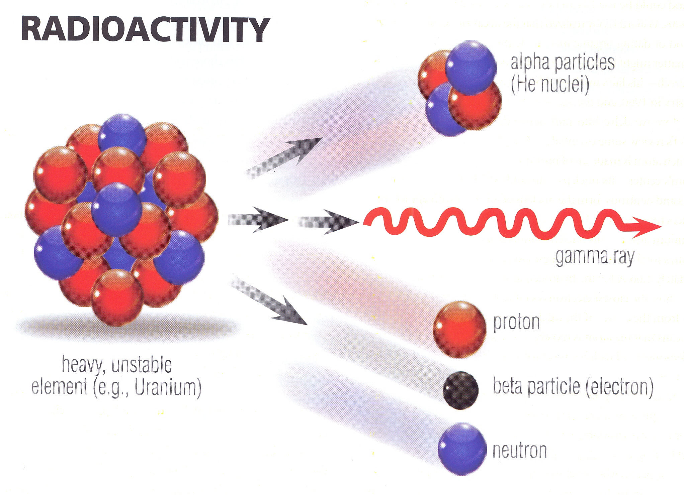
in a heavy, unstable element (e.g., U²³⁸)
in a heavy, unstable U²³⁸ = 92 protons & 146 neutrons
Neutrons in elements with large nuclei eject beta particles (electrons) – leaving them as protons. The proton-neutron ratio is now nearer 1 to 1, so the nucleus is more stable.
±
+
alpha particles (He nuclei)
±
+
+
±
±
Binding force drops on the outer protons as the nucleus increases in diameter
+
+
+
More neutrons between protons lowers their binding force & nucleus is unstable
gamma ray
±
±
neutron
For some outer protons, the coulomb repulsion overcomes the short distance strong binding force and 2 eject along with
2 neutrons as alpha particles (AMU = 4)
heavy, unstable element (e.g., Uranium)
–
beta particle (electron)
Large, heavy nuclei vibrate allowing alphas to wiggle a tiny bit farther from the nuclei’s center, helping it escape the strong force.
+
proton

Slide 18
Uranium to Lead Radioactive Decay
Half-Life Decay Rate = 4.5 Billion Years
Atoms with too many neutrons in the nucleus are unstable because their nuclei are too large for the nuclear binding strong force to hold all the subatomic particles together.
(especially the + charged protons, as they repel each other)
α
α
α
²³⁴U₉₂
²³⁰Th₉₀
²³⁴Pa₉₁
α
α
²³⁴Th₉₀
²²⁶Ra₈₈
β
²²²Rn₈₆
²³⁸U₉₂
β
Elements are Decaying in
Igneous Rocks
²¹⁸Po₈₄
β
²⁰⁶Pb₈₂
β
β
²¹⁴Pb₈₂
α
β
²¹⁰Po₈₄
²¹⁴Bi₈₃
²¹⁰Bi₈₃
²¹⁴Po₈₄
α
²¹⁰Pb₈₂
α

Slide 19
Uranium to Lead Radioactive Decay
Secular Half-Life Decay Rate = 4.5 Billion Years
2nd Law of
Thermodynamics
α
α
α
²³⁴U₉₂
²³⁰Th₉₀
²³⁴Pa₉₁
α
α
²³⁴Th₉₀
²²⁶Ra₈₈
β
²²²Rn₈₆
²³⁸U₉₂
β
Elements are α Decaying in
Igneous Rocks
²¹⁸Po₈₄
β
²⁰⁶Pb₈₂
β
β
²¹⁴Pb₈₂
α
β
²¹⁰Po₈₄
²¹⁴Bi₈₃
²¹⁰Bi₈₃
²¹⁴Po₈₄
α
²¹⁰Pb₈₂
α

Slide 20
We began with ₉₂U²³⁸
and finished at ₈₂Pb²⁰⁶
238 – 92 = 146 neutrons
206 – 82 = 124 neutrons
The spontaneous α decay process has
reduced the weight and size of the uranium nucleus and changed ₉₂U²³⁸ into Lead 206.
Lead 206 is stable because the short distance strong binding force of its smaller nucleus
can now overcome the repulsion force
of its positive charged protons on one another
and thereby hold these particles together.

